Slide 1
Program- 6
Assuming a set of documents that need to be classified, use the naïve Bayesian Classifier model to perform this task. Built-in Java classes/API can be used to write the program.
Calculate the accuracy, precision, and recall for your data set.

Slide 2
The naive Bayes algorithm
General setting. Consider an instance space X consisting of all possible text documents (i.e., all possible strings of words and punctuation of all possible lengths).
We are given training examples of some unknown target function f (x), which can take on any value from some finite set V.
The task is to learn from these training examples to predict the target value for subsequent text documents.
For illustration, we will consider the target function classifying documents as interesting or uninteresting to a particular person.
The target values like and dislike are used to to indicate these two classes.

Slide 3
Design Issues
To decide how to represent an arbitrary text document in terms of attribute values
To decide how to estimate the probabilities required by the naive Bayes classifier.

Slide 4
Design
Define an attribute for each word position in the document and define the value of that attribute to be the English word found in that position.
Consider a doc with 111 doc positions.Unfortunately, there are approximately 50,000 distinct words in the English vocabulary, 2 possible target values,
so we must estimate 2* 111*50,000 = 10 million such terms from the training data.
we shall assume the probability of encountering a specific word wk is independent of the specific word position being considered
2*50,000 distinct terms

Slide 5

Design
Thus, the estimate for P(wklvj) will be
where n is the total number of word positions in all training examples whose target value is vj,
nk is the number of times word wk is found among these n word positions, and
|Vocabulary| is the total number of distinct words found within the training data

Slide 6
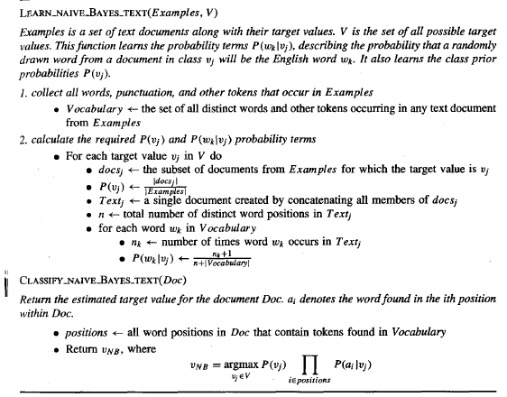

Slide 7
From sklearn.feature_extraction.text import CountVectorizer
>>> corpus = [
... 'This is the first document.',
... 'This document is the second document.',
... 'And this is the third one.',
... 'Is this the first document?',
... ]
>>> vectorizer = CountVectorizer()
>>> print(vectorizer.get_feature_names())
['and', 'document', 'first', 'is', 'one', 'second', 'the', 'third', 'this']
>>> X = vectorizer.fit_transform(corpus)
>>> print(X.toarray())
[[0 1 1 1 0 0 1 0 1]
[0 2 0 1 0 1 1 0 1]
[1 0 0 1 1 0 1 1 1]
[0 1 1 1 0 0 1 0 1]]

Slide 8
Accuracy, Recall, Precison
Accuracy- .Accuracy is the fraction of predictions our model got right. Formally, accuracy has the following definition: Accuracy=Number of correct predictions/Total number of predictions
precision (also called positive predictive value) is the fraction of relevant instances among the retrieved instances
Recall (also known as sensitivity) is the fraction of relevant instances that have been retrieved over the total amount of relevant instances.

Slide 9
Accuracy, Recall, Precison
Example:
Total documents- 40
Total Positive doc- 30
Total Negative doc -10
Total Predicted true- 25
Total Predicted correctly true- 20
Total correct prediction- 30
Precison is =20/25
Recall is= 20/30
Accuracy= 30/40

Slide 10
Accuracy, Recall, Precison
Accuracy=TP+TN / (TP+FP+TN+FN)
Precision = TP/(TP + FP)
Recall = TP/(TP+FN)
2 | 0
1 | 2

